Slide 1
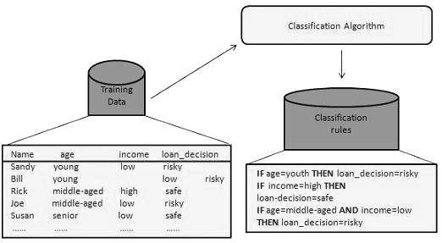
4. Data Mining Techniques :Classification
Classification: Definition of Classification
Decision tree Induction: Information gain, Issues: Over-fitting, tree pruning methods,
Bayesian Classification: Bayes Theorem, Naïve Bayes classifier, Bayesian Networks

Slide 2
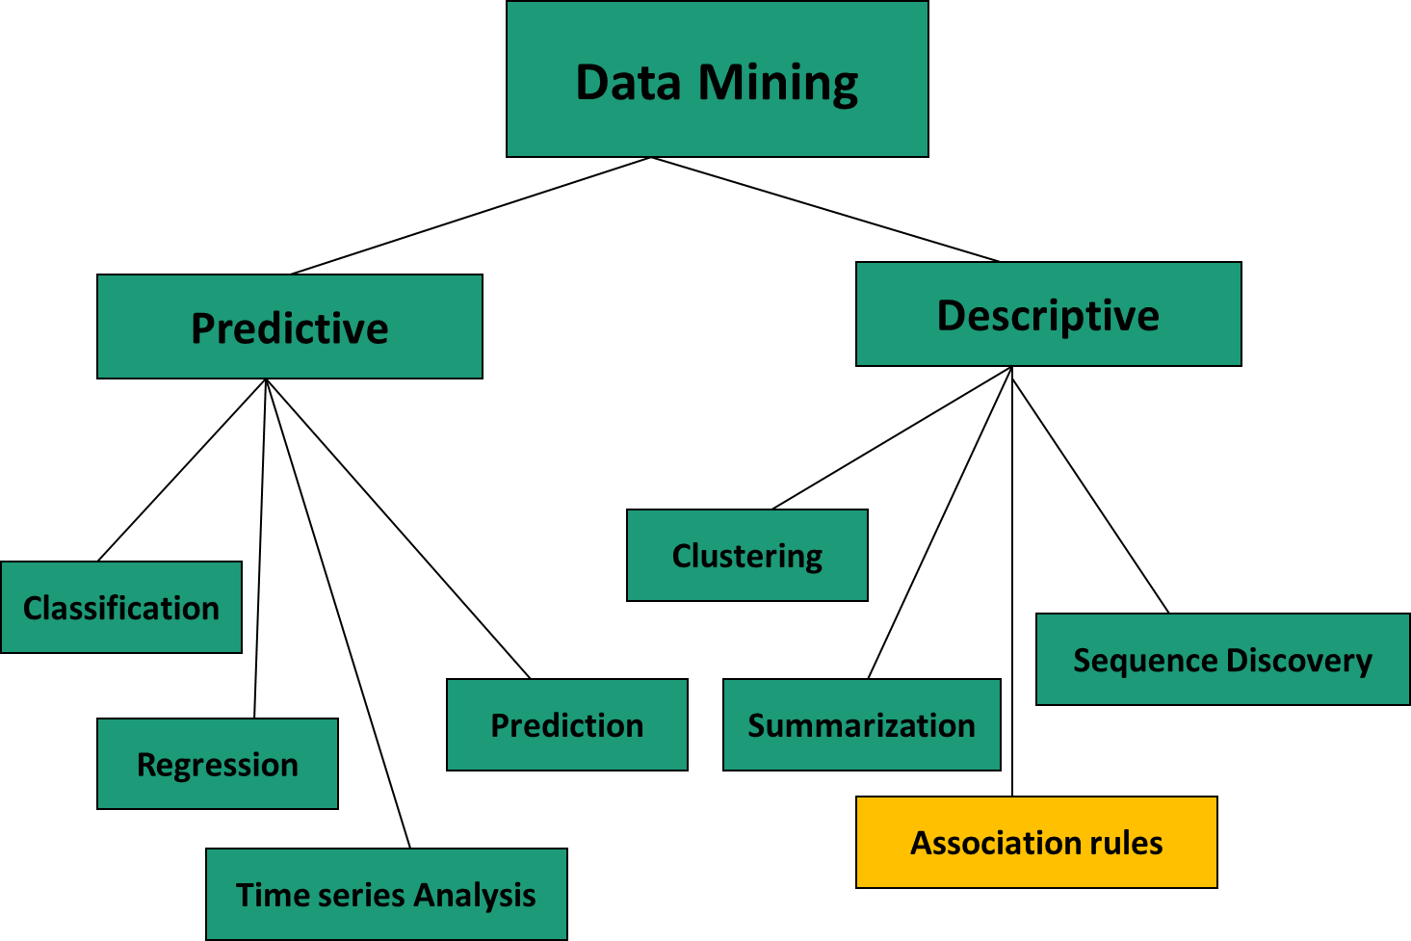
Data Mining Techniques

Slide 3
Classification
Data mining is the process of extracting interesting, non-trivial, implicit, previously unknown and potentially useful patterns or knowledge from huge amount of data
Classification Technique classifies data (constructs a model) based on the training set and the values (class labels) in a classifying attribute and uses it in classifying new data(prediction).

Slide 4
Classification process
Classification is a two step process:
Learning step (or training phase)
Where a classification algorithm builds the classifier by analyzing or “learning from” a training set made up of database tuples and their associated class labels.
A tuple, X, is represented by an n-dimensional attribute vector, X = (x1, x2,..., xn), depicting n measurements made on the tuple from n database attributes, respectively, A1, A2,..., An.
Each tuple, X, is assumed to belong to a predefined class as determined by another database attribute called the class label attribute.
The class label attribute is discrete-valued and unordered, it is categorical (or nominal) in that each value serves as a category or class.
The individual tuples making up the training set are referred to as training tuples

Slide 5
Because the class label of each training tuple is provided, this step is also known as supervised learning.
The classifier or model generated in the first step of classification algorithm can be a classification rules, decision trees, or mathematical formulae.
II classification step (or Testing Phase)
In second step the model is used for classification, first it is used on a test data to check its accuracy.
Estimate accuracy of the model ,the known label of test sample is compared with the classified result from the model
Accuracy rate is the percentage of test set samples that are correctly classified by the model
Test set is independent of training set, otherwise over-fitting will occur
If the accuracy is acceptable, use the model to classify data tuples whose class labels are not known

Slide 6
Classification : Example
Class label
Attributes
Patient Id | Sore throat | Fever | Swollen Glands | Congestion | Headache | Diagnosis
1 | Yes | Yes | Yes | Yes | Yes | Strep throat
2 | No | No | No | Yes | Yes | Allergy
3 | Yes | Yes | No | Yes | No | Cold
4 | Yes | No | No | No | No | Strep throat
5 | No | Yes | No | Yes | No | Cold
6 | No | No | No | Yes | No | Allergy
7 | No | No | Yes | No | No | Strep throat
8 | Yes | No | No | Yes | Yes | Allergy
9 | No | Yes | No | Yes | Yes | Cold
10 | Yes | Yes | No | Yes | Yes | Cold

Slide 7
Step I: Learning step (or training phase)
Classification
Algorithms
Training
Data
Patient Id | Sore throat | Fever | Swollen Glands | Congestion | Headache | Diagnosis
1 | Yes | Yes | Yes | Yes | Yes | Strep throat
2 | No | No | No | Yes | Yes | Allergy
3 | Yes | Yes | No | Yes | No | Cold
4 | Yes | No | No | No | No | Strep throat
5 | No | Yes | No | Yes | No | Cold
6 | No | No | No | Yes | No | Allergy
7 | No | No | Yes | No | No | Strep throat
8 | Yes | No | No | Yes | Yes | Allergy
9 | No | Yes | No | Yes | Yes | Cold
10 | Yes | Yes | No | Yes | Yes | Cold
Classifier
(Model)
Swollen
Glands
No
Yes
Fever
Diagnosis=Strep Throat
No
Yes
Diagnosis=Allergy
Diagnosis =Cold

Slide 8
Step II : Classification step (or testing phase)
Swollen
Glands
No
Yes
Test
Data
Fever
Diagnosis=Strep Throat
No
Yes
Diagnosis=Allergy
Diagnosis =Cold
Patient Id | Sore throat | Fever | Swollen Glands | Congestion | Headache | Diagnosis
1 | Yes | Yes | Yes | Yes | Yes | Strep throat
2 | No | No | No | Yes | Yes | Allergy
3 | Yes | Yes | No | Yes | No | Cold
4 | Yes | No | No | No | No | Strep throat
5 | No | Yes | No | Yes | No | Cold
6 | No | No | No | Yes | No | Allergy
7 | No | No | Yes | No | No | Strep throat
8 | Yes | No | No | Yes | Yes | Allergy
9 | No | Yes | No | Yes | Yes | Cold
10 | Yes | Yes | No | Yes | Yes | Cold
Accurate ?
Use model
Update model

Slide 9
Bayesian Classification
Bayesian classifiers are statistical classifiers
They can predict class membership probabilities such as the probability that a given tuple belongs to a particular class
Foundation : Bayesian classification is based on Bayes’ theorem
Performance: A simple Bayesian classifier, naïve Bayesian classifier, has comparable performance with decision tree and selected neural network classifiers

Slide 10
Bayes Theorem
Let X be a data sample (“evidence”): class label is unknown
Let H be a hypothesis that X belongs to class C
Classification is to determine P(H|X), (posteriori probability), the probability that the hypothesis holds given the observed data sample X
Ex. P(H|X) reflects the probability that customer X will buy a computer given that we know the customer’s age and income
P(H) (prior probability), the initial probability
E.g., X will buy computer, regardless of age, income, …
P(X): probability that sample data is observed
Ex. it is the probability that a person from our set of customers is 35 years old and earns $40,000.

Slide 11
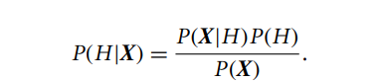
Bayes Theorem
P(X|H) (likelyhood), the probability of observing the sample X, given that the hypothesis holds
Ex. it is the probability that a customer, X, is 35 years old and earns $40,000, given that we know the customer will buy a computer
Bayes’ theorem is useful in that it provides a way of calculating the posterior probability, P(H|X), from P(H), P(X|H), and P(X).
Bayes Theorem :

Slide 12
naıve bayesian classification : Example
Class:
C1:buys_computer = ‘yes’
C2:buys_computer = ‘no’
Data sample
X = (age <=30,
Income = medium,
Student = yes
Credit_rating = Fair)

Slide 13
1. P(C_{i}): P(buys_computer = “yes”) = 9/14 = 0.643
P(buys_computer = “no”) = 5/14= 0.357
2. Compute P(X|C_{i}) for each class
P(age = “<=30” | buys_computer = “yes”) = 2/9 = 0.222
P(age = “<= 30” | buys_computer = “no”) = 3/5 = 0.6
P(income = “medium” | buys_computer = “yes”) = 4/9 = 0.444
P(income = “medium” | buys_computer = “no”) = 2/5 = 0.4
P(student = “yes” | buys_computer = “yes) = 6/9 = 0.667
P(student = “yes” | buys_computer = “no”) = 1/5 = 0.2
P(credit_rating = “fair” | buys_computer = “yes”) = 6/9 = 0.667
P(credit_rating = “fair” | buys_computer = “no”) = 2/5 = 0.4

Slide 14
3. X = (age <= 30 , income = medium, student = yes, credit_rating = fair)
P(X|C_{i}) : P(X|buys_computer = “yes”) = 0.222 x 0.444 x 0.667 x 0.667
= 0.044
P(X|buys_computer = “no”) = 0.6 x 0.4 x 0.2 x 0.4 = 0.019
4. P(X|C_{i})*P(C_{i}) : P(X|buys_computer = “yes”) * P(buys_computer = “yes”)
= 0.028
5. P(X|buys_computer = “no”) * P(buys_computer = “no”) = 0.007
Therefore, X belongs to class (“buys_computer = yes”)

Slide 15
Bayesian networks
A Bayesian network is defined by two components—a directed acyclic graph and a set of conditional probability tables
Each node in the directed acyclic graph represents a random variable.
The variables may be discrete- or continuous-valued
Each arc represents a probabilistic dependence
If an arc is drawn from a node Y to a node Z, then Y is a parent or immediate predecessor of Z, and Z is a descendant of Y.
Each variable is conditionally independent of its nondescendants in the graph, given its parents.

Slide 16
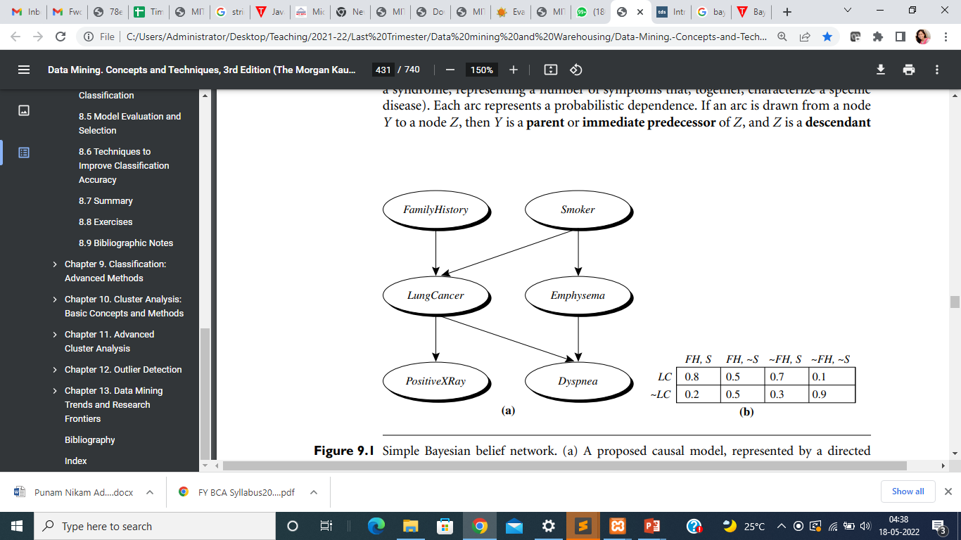
Example:
A proposed causal model, represented by a directed acyclic graph.
The conditional probability table for the values of the variable LungCancer (LC) showing each possible combination of the values of its parent nodes, FamilyHistory (FH) and Smoker (S).

Slide 17
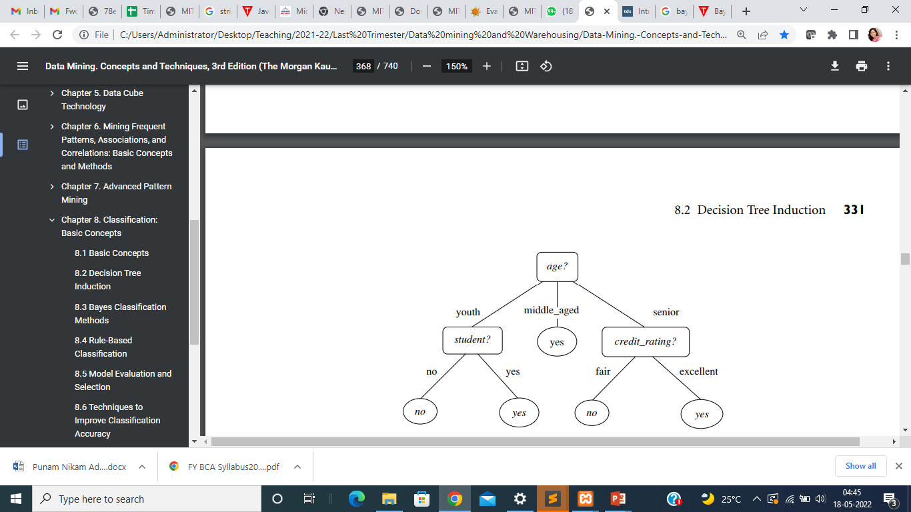
Decision tree induction
Decision tree induction is the learning of decision trees from class-labeled training tuples
A decision tree is a flowchart-like tree structure, where each internal node (nonleaf node) denotes a test on an attribute, each branch represents an outcome of the test, and each leaf node (or terminal node) holds a class label.
The topmost node in a tree is the root node.

Slide 18
Use of decision tree for classification :” Given a tuple, X, for which the associated class label is unknown, the attribute values of the tuple are tested against the decision tree. A path is traced from the root to a leaf node, which holds the class prediction for that tuple.
Decision trees can easily be converted to classification rules

Slide 19
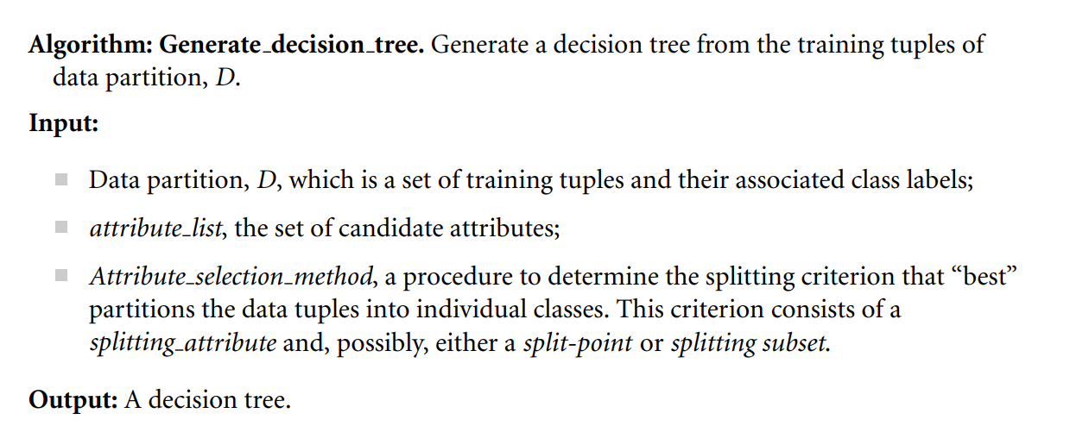
Basic Decision Tree algorithm

Slide 20
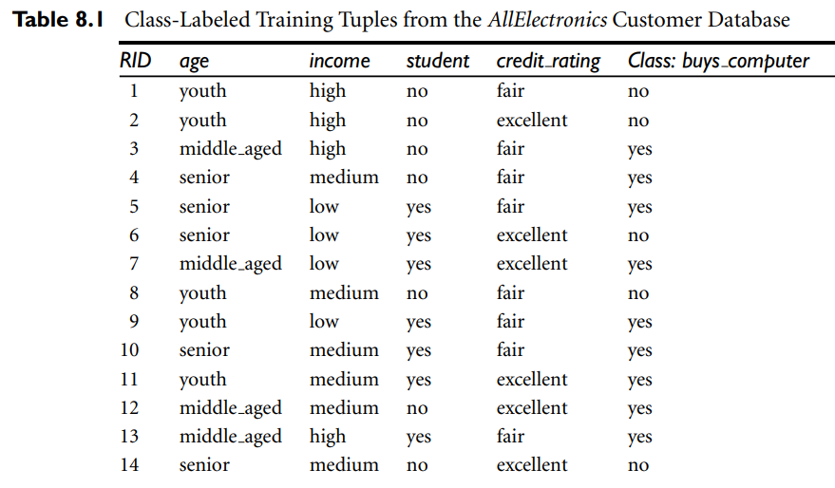
Decision tree algorithm input
D

Slide 21
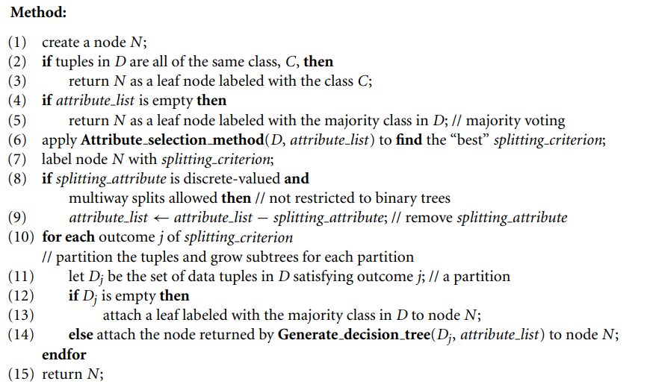
Basic Decision Tree algorithm

Slide 22
Attribute Selection Measures
An attribute selection measure is a heuristic for selecting the splitting criterion that “best” separates a given data partition, D, of class-labeled training tuples into individual classes.
If we were to split D into smaller partitions according to the outcomes of the splitting criterion, ideally each partition would be pure (i.e., all the tuples that fall into a given partition would belong to the same class).
Attribute selection measures are also known as splitting rules because they determine how the tuples at a given node are to be split.
The attribute selection measure provides a ranking for each attribute describing the given training tuples.
Information gain is a attribute selection measure

Slide 23
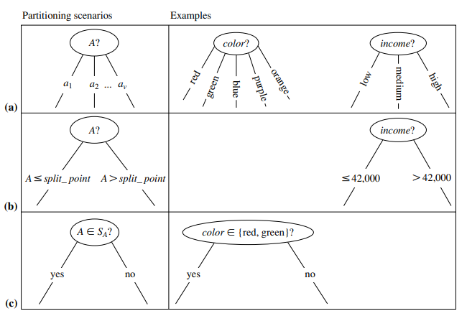
Possibilities for partitioning tuples based on the splitting criterion, each with examples
A is discrete-valued
A is continuous-valued
A is discrete-valued and a binary tree must be produced

Slide 24
Possibilities for partitioning tuples based on the splitting criterion, each with examples
A is discrete-valued: In this case, the outcomes of the test at node N correspond directly to the known values of A. A branch is created for each known value, aj , of A and labeled with that value
A is continuous-valued: In this case, the test at node N has two possible outcomes, corresponding to the conditions A ≤ split point and A > split point, respectively, where split point is the split-point returned by Attribute selection method as part of the splitting criterion.
A is discrete-valued and a binary tree must be produced (as dictated by the attribute selection measure or algorithm being used): The test at node N is of the form “A ∈ SA?,” where SA is the splitting subset for A, returned by Attribute selection method as part of the splitting criterion. It is a subset of the known values of A.

Slide 25
Use of information gain for attribute selection
Let node N represent or hold the tuples of partition D.
The attribute with the highest information gain is chosen as the splitting attribute for node N.
This attribute minimizes the information needed to classify the tuples in the resulting partitions and reflects the least randomness or “impurity” in these partitions.
Such an approach minimizes the expected number of tests needed to classify a given tuple and guarantees that a simple (but not necessarily the simplest) tree is found.

Slide 26
Steps:
Calculate expected information Info(D) needed to classify a tuple in D(partition)
InfoA (D) is the expected information required to classify a tuple from D based on the partitioning by attribute A
Information gain is defined as the difference between the original information requirement (i.e., based on just the proportion of classes) and the new requirement (i.e., obtained after partitioning on A).
Information gain is defined as the difference between the original information requirement (i.e., based on just the proportion of classes) and the new requirement (i.e., obtained after partitioning on A).
Gain(A) = Info(D) − InfoA (D).
5. The attribute A with the highest information gain, Gain(A), is chosen as the splitting attribute at node N.

Slide 28
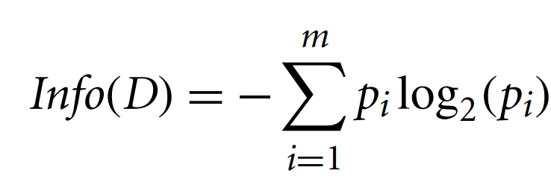
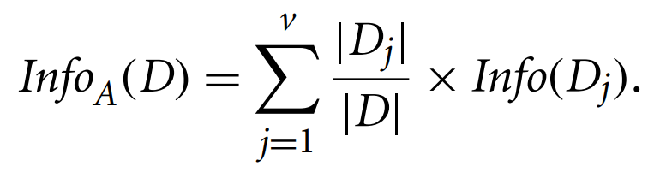
Where m, is the number of classes, p_{i} is the probability that the arbitrary tuple in D can belong to class C_{i}
The term |Dj | |D| acts as the weight of the jth partition,
∣Dj∣: This denotes the absolute value of the quantity associated with the jth partition.
∣D∣: This represents the absolute value of the entire set or partition.

Slide 29
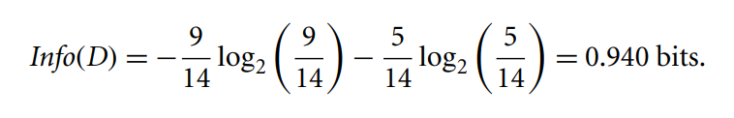
In this example class label attribute buys_computer have two values yes and no.
Therefore, there are two classes ,C1=yes and c2=no
Expected information needed to classify tuple in D is

Slide 30
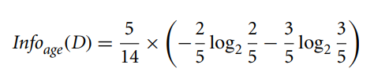
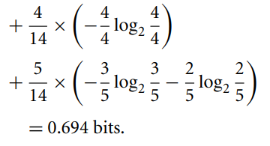
Next, we need to compute the expected information requirement for each attribute.
Expected information required for attribute age
We need to look the distribution of yes and no tuple for each category of age
youth = two yes tuples and three no tuples
Middle_aged = four yes tuple
Senior = three yes tuples and two no tuples

Slide 31
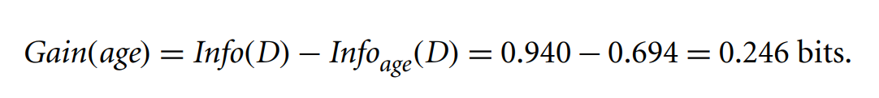
Hence the information gain from such partitioning would be

Slide 32
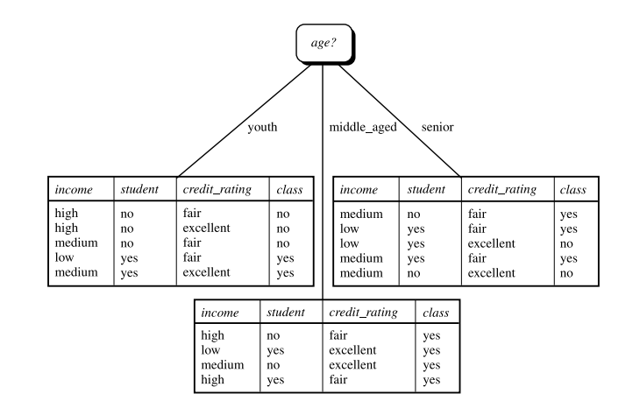
Similarly, we can compute Gain(income) = 0.029 bits, Gain(student) = 0.151 bits, and Gain(credit rating) = 0.048
Because age has the highest information gain among the attributes, it is selected as the splitting attribute. Node N is labeled with age, and branches are grown for each of the attribute’s values.

Slide 33
Decision tree issue s
Tree pruning :
When a decision tree is built, many of the branches will reflect anomalies in the training data due to noise or outliers.
Tree pruning methods address this problem of overfitting the data.
pruning methods typically use statistical measures to remove the least-reliable branches.
There are two common approaches of tree pruning
1. prepruning : Halt tree construction early
2. Postpruning: Remove branches from a “fully grown” tree

Slide 34
Tree pruning :
When a decision tree is built, many of the branches will reflect anomalies in the training data due to noise or outliers.
Tree pruning methods address this problem of overfitting the data.
pruning methods typically use statistical measures to remove the least-reliable branches.
There are two common approaches of tree pruning
1. prepruning : Halt tree construction early
2. Postpruning: Remove branches from a “fully grown” tree

Slide 35
Decision tree issue
Prepruning : , a tree is “pruned” by halting its construction early
Steps of preprunning
Set the threshold : Decide the threshold value to determine whether further partitioning of the subset at a node should be halted.
Evaluate the split quality: During the construction, assess the quality of a potential split using measures like statistical significance, information gain, or Gini index.
Check threshold condition :If the calculated measure for the split falls below the prespecified threshold, decide not to further split or partition the subset at the current node.
Create Leaf node :Upon halting the split, designate the current node as a leaf node in the decision tree.The leaf may hold the most frequent class among the subset tuples or the probability distribution of those tuples.
There are difficulties, however, in choosing an appropriate threshold. High thresholds could result in oversimplified trees, whereas low thresholds could result in very little simplification.

Slide 36
Postpruning : Remove branches from a “fully grown” tree
Steps of postpruning
Build a Fully Grown Tree :Start by constructing a fully grown decision tree
Define Cost Complexity: cost complexity can be function of function of the number of leaves in the tree and the error rate of the tree.
Apply bottom up pruning : Begin the pruning process from the bottom of the tree. Traverse each internal node, N, starting with the leaf nodes.
Compute cost complexity : Compute the cost complexity of the tree at the internal node for subtree without pruning and with pruning
Compare complexities and take decision for subtree pruning : Compare the cost complexity of the current subtree with the cost complexity of the pruned subtree. Evaluate whether pruning the subtree at node N would result in a smaller cost complexity. If pruning the subtree at node N would result in a smaller cost complexity, prune the subtree. Remove its branches and replace it with a leaf labeled with the most frequent class among the subtree being replaced.

Slide 37
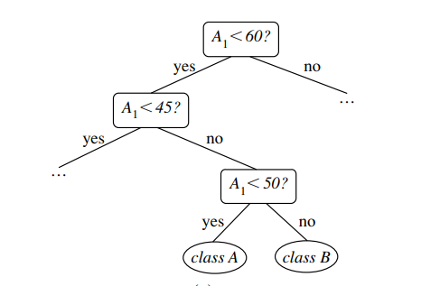
Decision tree issues
1. Repetition : when an attribute is repeatedly tested along a given branch of the tree

Slide 38
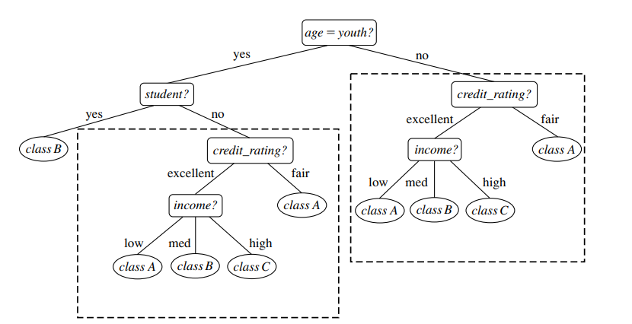
Decision tree issues
2. Replication: duplicate subtrees exist within the tree.

Slide 39
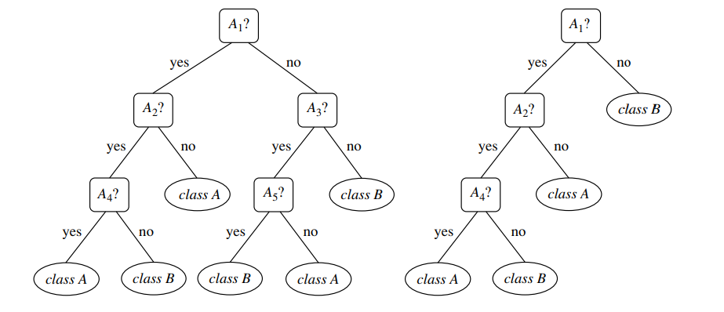
Example of post prunning

Slide 40
Bayesian Classification: Bayes Theorem, Naïve Bayes classifier, Bayesian Networks
Bayesian classifiers?
Bayesian classifiers are statistical classifiers.
They can predict class membership probabilities such as the probability that a given tuple belongs to a particular class.
Bayesian classification is based on Bayes’ theorem
Performance: A simple Bayesian classifier, naïve Bayesian classifier, has comparable performance with decision tree and selected neural network classifiers

Slide 41
Bayes Theorem
Let X be a data sample (“evidence”): class label is unknown
Let H be a hypothesis that X belongs to class C
Classification is to determine P(H|X), (posteriori probability), the probability that the hypothesis holds given the observed data sample X
Ex. P(H|X) reflects the probability that customer X will buy a computer given that we know the customer’s age and income
P(H) (prior probability), the initial probability
E.g., X will buy computer, regardless of age, income, …
P(X): probability that sample data is observed
Ex. it is the probability that a person from our set of customers is 35 years old and earns $40,000.

Slide 42
Bayes Theorem
P(X|H) (likelyhood), the probability of observing the sample X, given that the hypothesis holds
Ex. it is the probability that a customer, X, is 35 years old and earns $40,000, given that we know the customer will buy a computer
Bayes’ theorem is useful in that it provides a way of calculating the posterior probability, P(H|X), from P(H), P(X|H), and P(X).
Bayes Theorem :

Slide 43
Naıve Bayesian Classification
Naïve Bayes is a probabilistic machine learning algorithm used in a wide variety of classification tasks.
It is a classification technique based on Bayes’ Theorem with an assumption of independence among predictors.
Prediction of membership probabilities is made for every class such as the probability of data points associated to a particular class.
The class having maximum probability is appraised as the most suitable class.
Bayes Theorem
Where
P(H/X) : Conditional probability of of H given X
P(X/H) : Conditional probability of X given H
P(X) : Probability of event X
P(H) : Probability of event H

Slide 44

Naıve Bayesian Classification
Let D be a training set of tuples and their associated class labels. As usual, each tuple is represented by an n-dimensional attribute vector, X = (x1, x2,..., xn), depicting n measurements made on the tuple from n attributes, respectively, A1, A2,..., An.
Suppose that there are m classes, C1, C2,..., Cm. Given a tuple, X, the classifier will predict that X belongs to the class having the highest posterior probability, conditioned on X. That is, the na¨ıve Bayesian classifier predicts that tuple X belongs to the class Ci if and only if

Slide 45
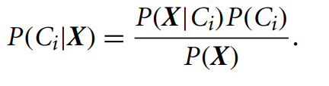
Naıve Bayesian Classification
Thus, we maximize P(Ci |X). The class Ci for which P(Ci |X) is maximized is called the maximum posteriori hypothesis. By Bayes’ theorem
As P(X) is constant for all classes, only P(X|Ci)P(Ci) needs to be maximized.

Slide 46
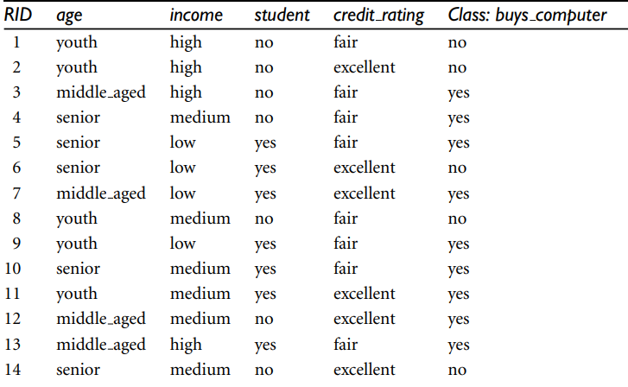
Example
We wish to predict the class label of a tuple using naïve Bayesian classification,given some training data
Class
C1:buys_computer = ‘yes’
C2:buys_computer = ‘no’
Tuple we wish to classify is
X = (youth,
Income = medium,
Student = yes
Credit_rating = Fair)

Slide 47
Example
We need to maximize P(X|Ci)P(Ci), for i = 1, 2. P(Ci), the prior probability of each class, can be computed based on the training tuples
P(C_{i}): P(buys_computer = “yes”) = 9/14 = 0.643
P(buys_computer = “no”) = 5/14= 0.357

Slide 48
Example
To compute P(X|Ci), fori = 1, 2, we compute the following conditional probabilities:
P(age = youth | buys computer = yes) = 2/9 = 0.222
P(age = youth | buys computer = no) = 3/5 = 0.600
P(income = medium | buys computer = yes) = 4/9 = 0.444
P(income = medium | buys computer = no) = 2/5 = 0.400
P(student = yes | buys computer = yes) = 6/9 = 0.66
P(student = yes | buys computer = no) = 1/5 = 0.200
P(credit rating = fair | buys computer = yes) = 6/9 = 0.667
P(credit rating = fair | buys computer = no) = 2/5 = 0.400

Slide 49
Example
Using probabilities computed in previous steps we obtain
P(X|buys computer = yes) = P(age = youth | buys computer = yes)
× P(income = medium | buys computer = yes)
× P(student = yes | buys computer = yes)
× P(credit rating = fair | buys computer = yes)
= 0.222 × 0.444 × 0.667 × 0.667 = 0.044.
Similarly,
P(X|buys computer = no) = 0.600 × 0.400 × 0.200 × 0.400 = 0.019

Slide 50
To find the class, Ci , that maximizes P(X|Ci)P(Ci), we compute
P(X|buys computer = yes)P(buys computer = yes) = 0.044 × 0.643 = 0.028 P(X|buys computer = no)P(buys computer = no) = 0.019 × 0.357 = 0.007
Therefore, the na¨ıve Bayesian classifier predicts buys computer = yes for tuple X.
X = (age =youth,
Income = medium,
Student = yes
Credit_rating = Fair)

Slide 51
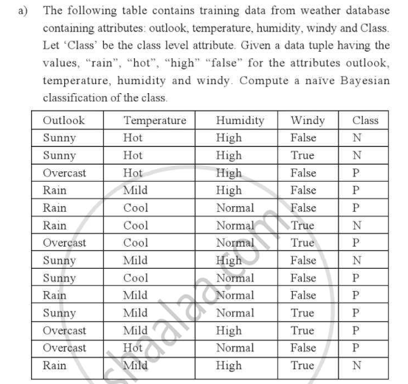

Slide 52
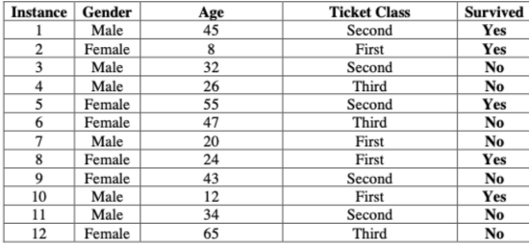

Slide 53
Revision
Define classification? Explain steps of classification process
Explain decision tree induction. Explain how information gain as a attribute selection measure in decision tree induction
What is supervised Learning.
State and explain Bayes theorm
Explain decision tree induction
What is tree pruning?
Explain information gain measure in detail
Problem solving (Find out information gain for given labled training dataset
Problem solving (Predict the class of tuple using Naıve Bayesian Classification)

